Slide 1
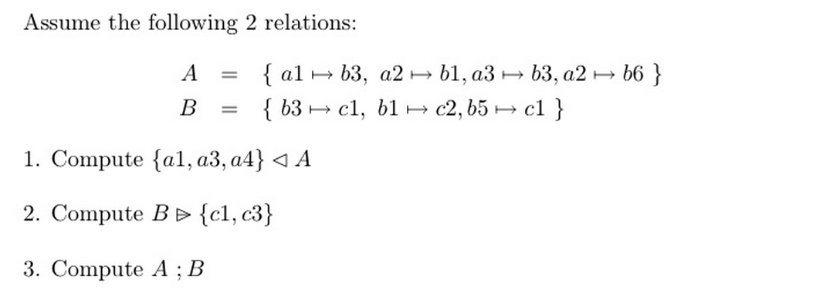
Exercises using Relations
4.
In a university degree programme, students are registered on courses.
Students must be enrolled on the degree programme to be registered in a course.
(There is no need to consider multiple degree programmes - just assume we are modelling a single degree programme).
Assume the types STUDENT and COURSE are defined in a context.
Define Event-B variables and invariants that represent the enrolled students in the degree programme and also the courses that students are registered in. Ensure the invariants are sufficiently strong.
Include an event for enrolling a student on the programme.
Include an event for registering a student in a course. Ensure the guards are sufficiently strong.
Include an event for de-enrolling a student from the degree programme.
Include an event for removing a course from the degree programme.

